Slide 1
BeyoND GPT-3
Pathways language model (palm)
Dall•E 2
Gene Olafsen

Slide 2
references
Google AI Blog: Pathways Language Model (PaLM): Scaling to 540 Billion Parameters for Breakthrough Performance (googleblog.com)
DALL·E 2 (openai.com)

Slide 3
GPT-3 Ove
Generative Pre-trained Transformer 3 (GPT-3) is the largest (175 billion trainable parameters), most capable, language model (a statistical tool to predict the next word(s) in a sequence) that leverages deep learning to generate human-like text. But GPT-3 doesn't stop there... it can also generate code, stories, poems, etc. GPT-3 falls into the machine learning category known as natural language processing (NLP).
Where does GPT-3 come from?
OpenAI is an AI research and deployment company. Whose mission is to ensure that artificial general intelligence benefits all of humanity.

Slide 4
Enter Palm
Google's AI research group introduces the Pathways Language Model (PaLM).
Google Research announced our vision for Pathways, a single model that could generalize across domains and tasks while being highly efficient.
A 540-billion parameter, dense decoder-only Transformer model trained with the Pathways system.
PaLM demonstrates the first large-scale use of the Pathways system to scale training to 6,144 chips, the largest TPU-based system configuration used for training to date.

Slide 5
Palm Performs
PaLM was evaluated on hundreds of language understanding and generation tasks, and found that it achieves state-of-the-art few-shot performance across most tasks, by significant margins in many cases.

Slide 6
Training efficiency
PaLM achieves a training efficiency of 57.8% hardware FLOPs utilization, the highest yet achieved for LLMs at this scale. This is due to a combination of the parallelism strategy and a reformulation of the Transformer block that allows for attention and feedforward layers to be computed in parallel, enabling speedups from TPU compiler optimizations.

Slide 7
Training corpus
A combination of English and multilingual datasets:
High-quality web documents
Books
Wikipedia
Conversations
GitHub code
Google Research also created a “lossless” vocabulary that preserves all whitespace (especially important for code), splits out-of-vocabulary Unicode characters into bytes, and splits numbers into individual tokens, one for each digit.

Slide 8
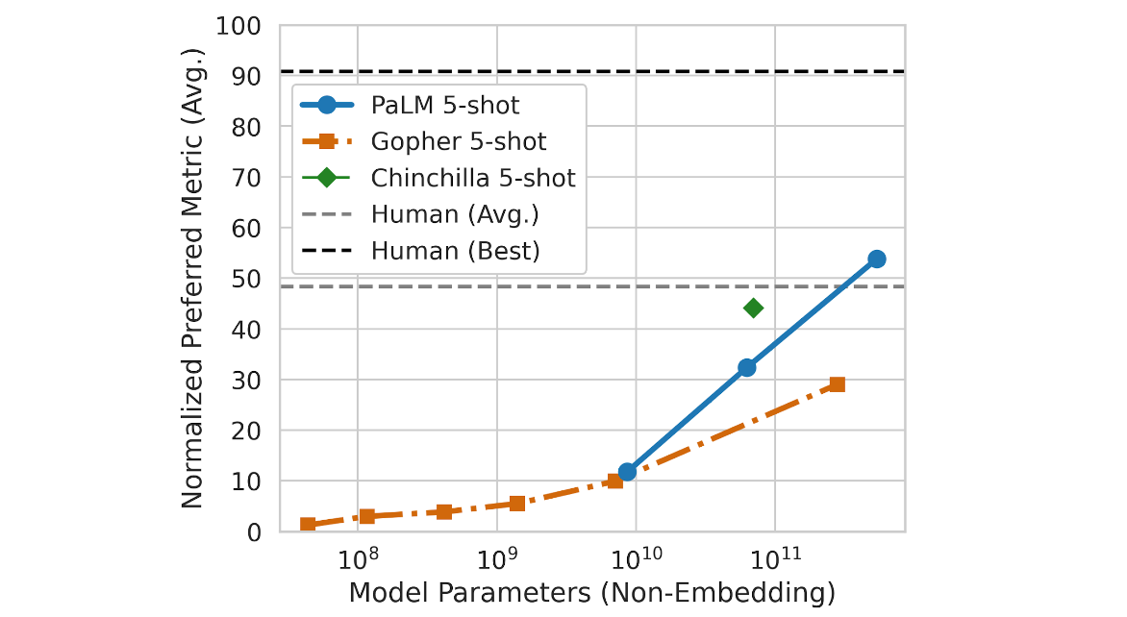
performance
PaLM’s performance as a function of scale follows a log-linear behavior similar to prior models, suggesting that performance improvements from scale have not yet plateaued.
PaLM 540B 5-shot also does better than the average performance of people asked to solve the same tasks.

Slide 9
1-shot Performance
Open tab showing 1-shot performance.

Slide 10
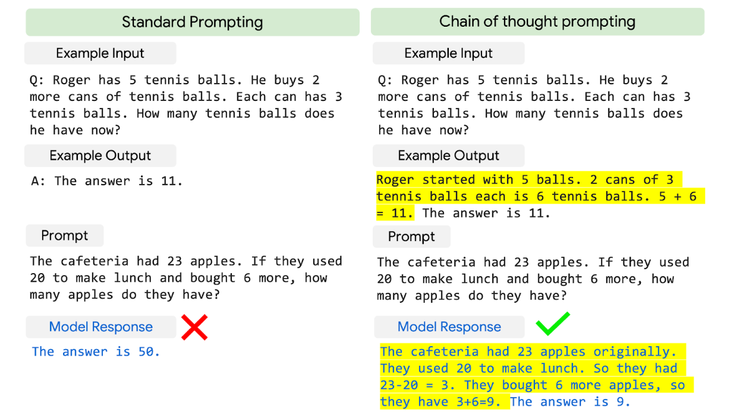
reasoning
By combining model scale with chain-of-thought prompting, PaLM shows breakthrough capabilities on reasoning tasks that require multi-step arithmetic or common-sense reasoning.

Slide 11
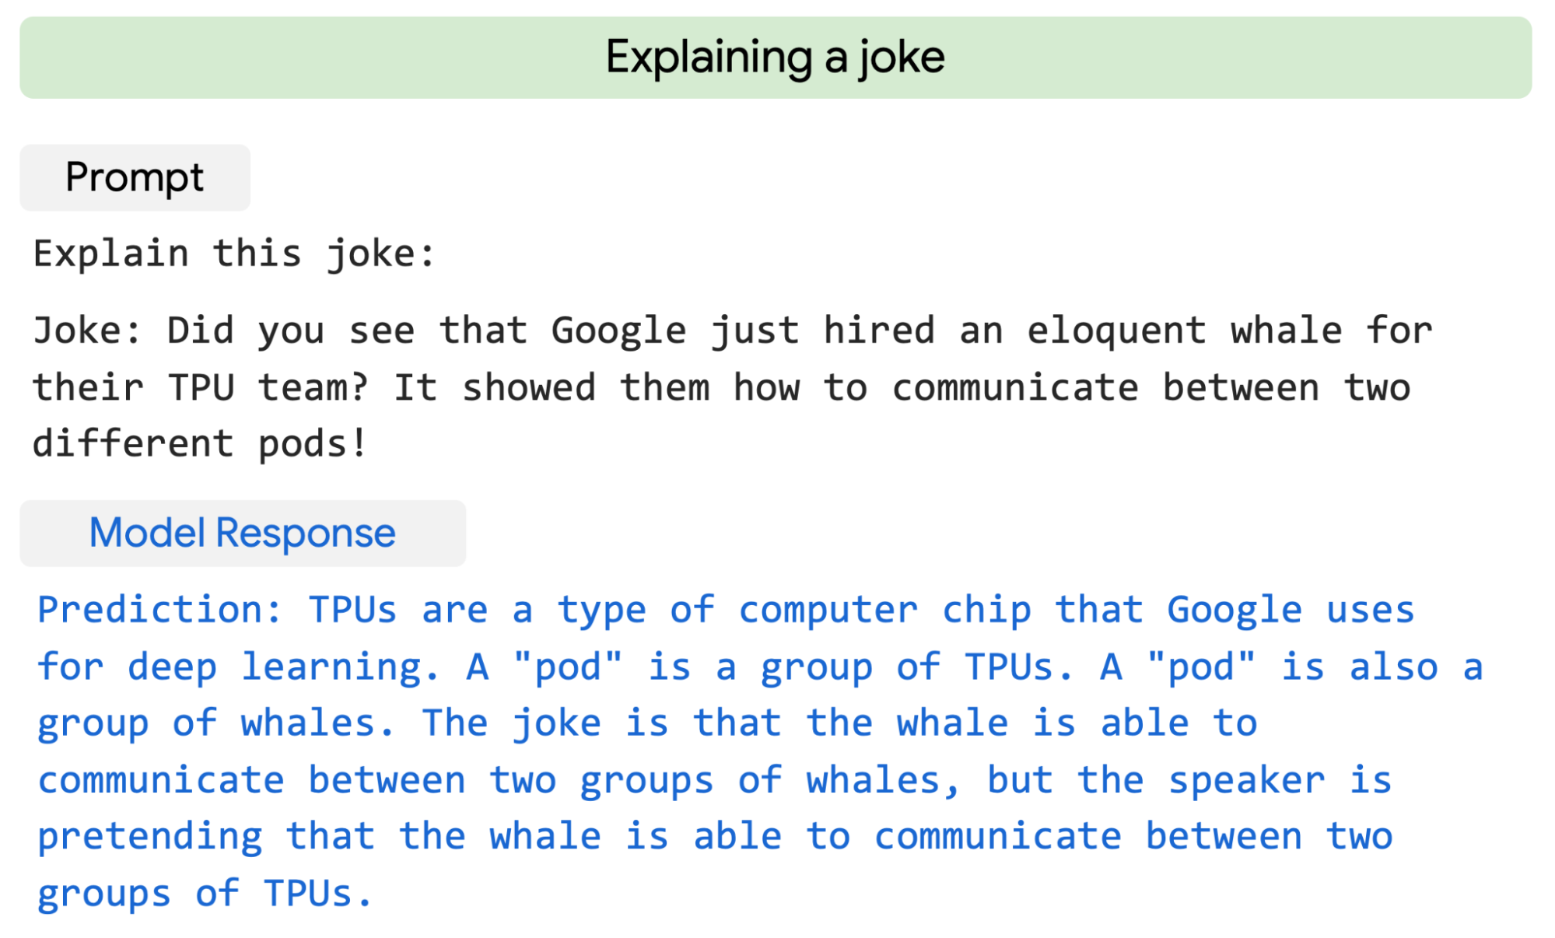
Explaining a joke
PaLM can provide high quality explanations for novel jokes not found on the web

Slide 12
coding
PaLM 540B shows strong performance across coding tasks and natural language tasks in a single model, even though it has only 5% code in the pre-training dataset.
Open tab showing coding examples.

Slide 13
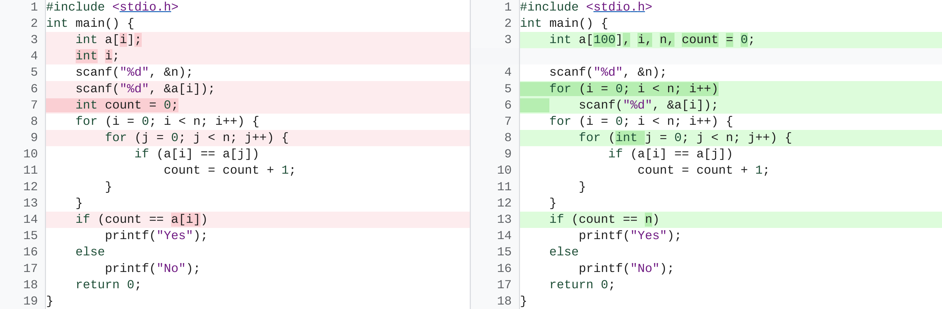
Code repair
An example code repair task called DeepFix, where the objective is to modify initially broken C programs until they compile successfully, PaLM-Coder 540B demonstrates impressive performance, achieving a compile rate of 82.1%, which outperforms the prior 71.7% state of the art.

Slide 14
ethics
"Recent research has highlighted various potential risks associated with LLMs trained on web text. It is crucial to analyze and document such potential undesirable risks through transparent artifacts such as model cards and datasheets, which also include information on intended use and testing. To this end, our paper provides a datasheet, model card and Responsible AI benchmark results, and it reports thorough analyses of the dataset and model outputs for biases and risks. While the analysis helps outline some potential risks of the model, domain- and task-specific analysis is essential to truly calibrate, contextualize, and mitigate possible harms."

Slide 15
DALL•E 2
DALL·E 2 is a new AI system that can create realistic images and art from a description in natural language. It can combine concepts, attributes, and styles.

